Slide 1


InterViewR
Master the art of asking
David Eduard
Dragos Ciota
Crisan Dragos
Ciurtea Alexandru
Denis Moldovan

Slide 2
WHAT IS INTERVIEWR?
With InterViewR, we aim to develop a people-free environment for people to train their communication skills, by having a normal conversation with a chat-bot that can empathize with the person.
We try to analyze the conversation as it’s flowing and see how much information you gather, to help you improve the way you ask questions.

Slide 3
KEYPOINTS
1
2
3
4
BUSINESS
TECHNICAL
DEMO
Q&A

Slide 4
Business

Slide 5

Market Opportunities
Societal changes:
Helping companies find the most fitting hires, solving low employee retention rate;
Helping people communicate more efficient by simulating genuine conversations;
Tehnological integration:
Incorporating AI in training for better and faster results;
New tehnologies:
Bringing augmented reality to ease the training process;

Slide 6
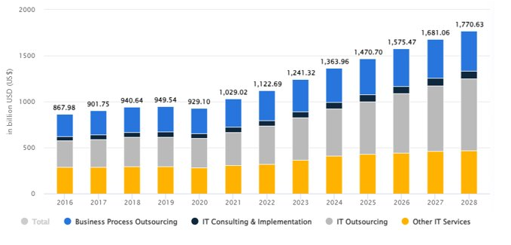
Market Opportunities
There is a lot of space for growth on our platform because the IT sector expanded by 6% YoY and the AI field is growing

Slide 7
CUSTOMER NEEDS
01
02
03
04
Reduce miscommunication
Find better suited hires
Reduce training costs
Have an always available training environment

Slide 8
PERSONA
JOHN DOE
Thinks
Age: 30 years old
”I don’t want my mentors to lose so much time training new employees”
“Maybe I can find better hires for my company
Gender: Male/Female
Job: Business owner
FEELS
GOALS
Concerned that the new hired people will leave the company fast because they don’t fit
Find better suited people for his company

Slide 9
Value Proposition
01
02
03
04
Improve value of new hires
Reduce need of suitable mentors for training
Increase long-term profit
Easy to use tools and readily available support
Having a people-free environment dedicated to empowering individuals in honing their interviewing and social skills

Slide 10
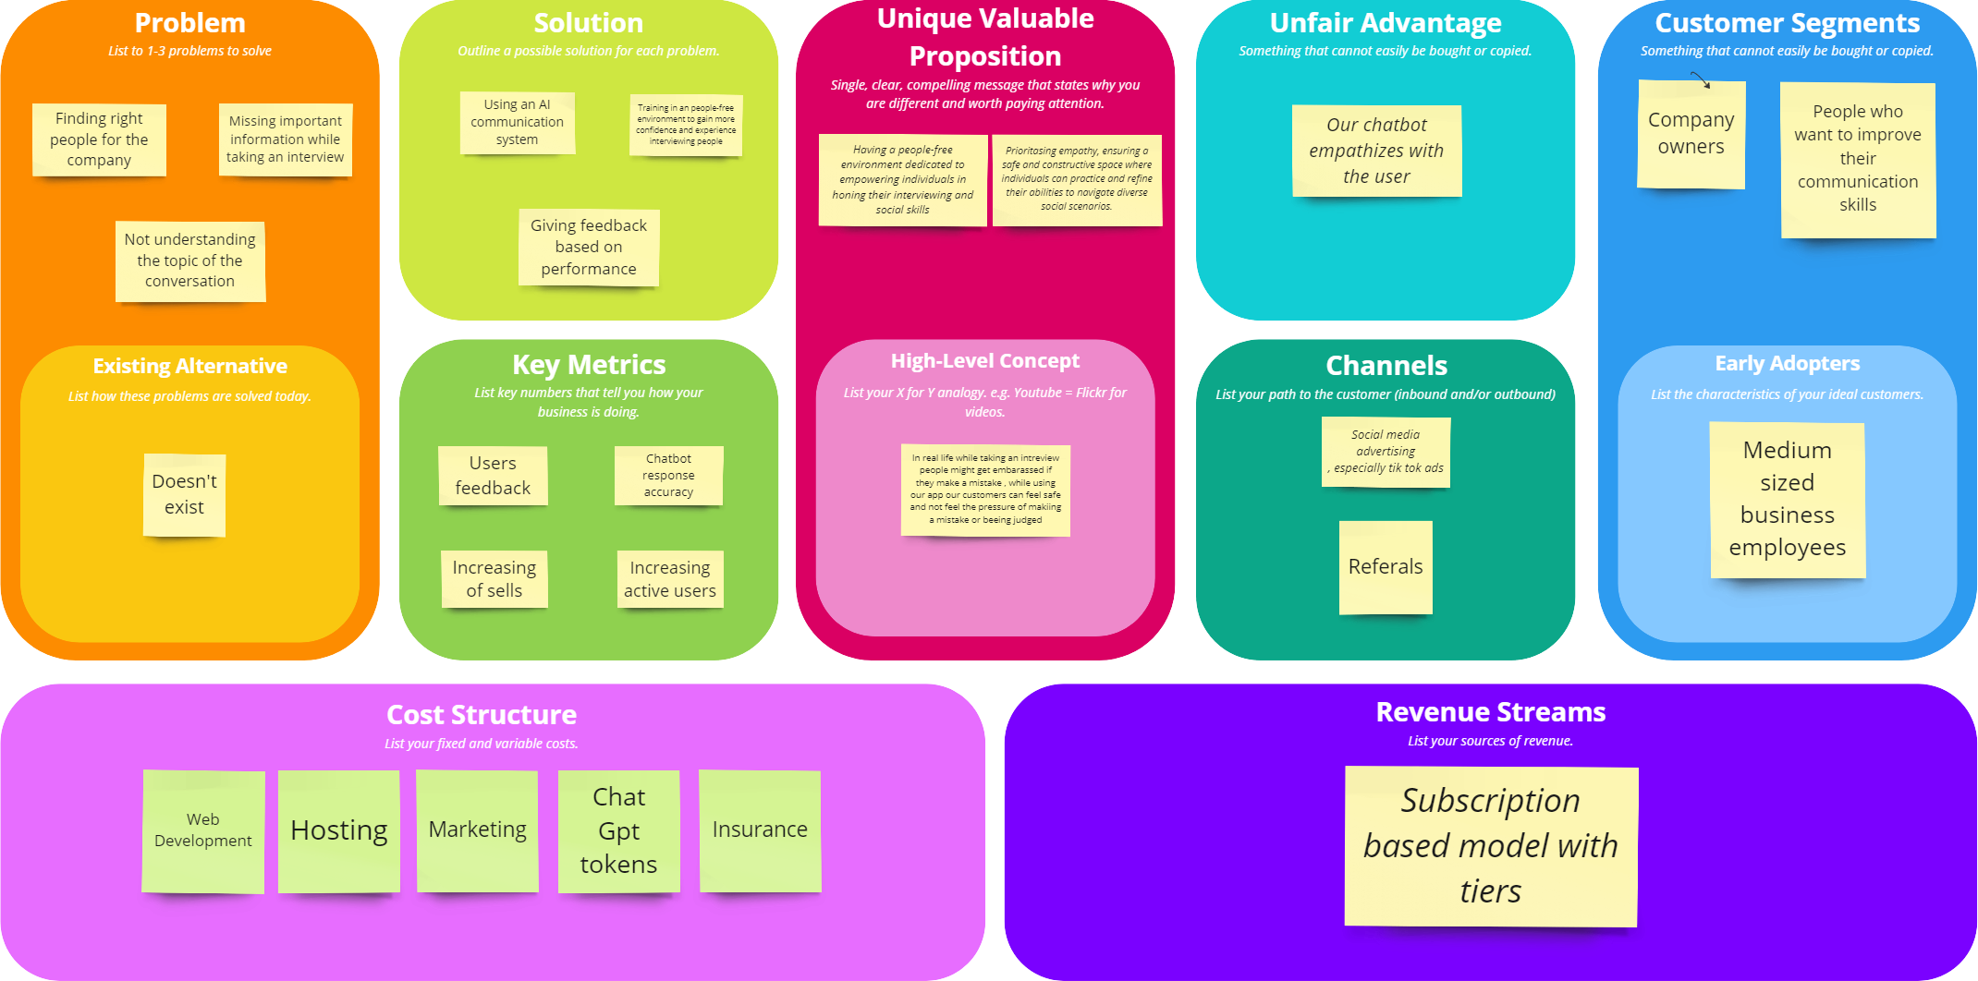
Bussiness Model

Slide 11
Tech

Slide 12
APPLICATION TYPE
CURRENT IMPLEMENTATION
FUTURE IMPLEMENTATION
Web application
Web application for analytics
HOLOLENS AR application for interview

Slide 13
APPLICATION INFRASTRUCTURE
Frontend
Self-made app in Angular and tailwind hosted on amazon
Backend
Self-made app in Java spring hosted on render
Integration of Chat-GPT4 model

Slide 14
INNOVATION
USING AI TO SIMULATE A GENUINE CONVERSATION, WHERE EMOTIONS ARE INVOLVED

Slide 15
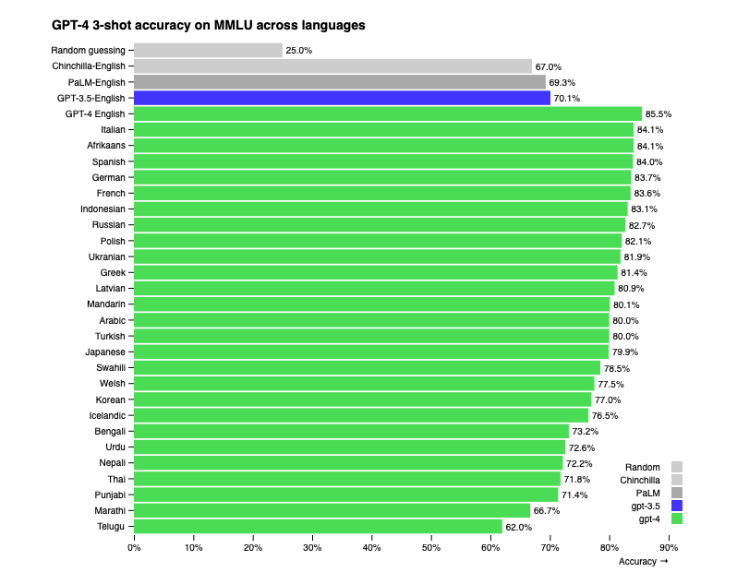
AI MODEL ACCURACY

Slide 16
DEMO

Slide 17
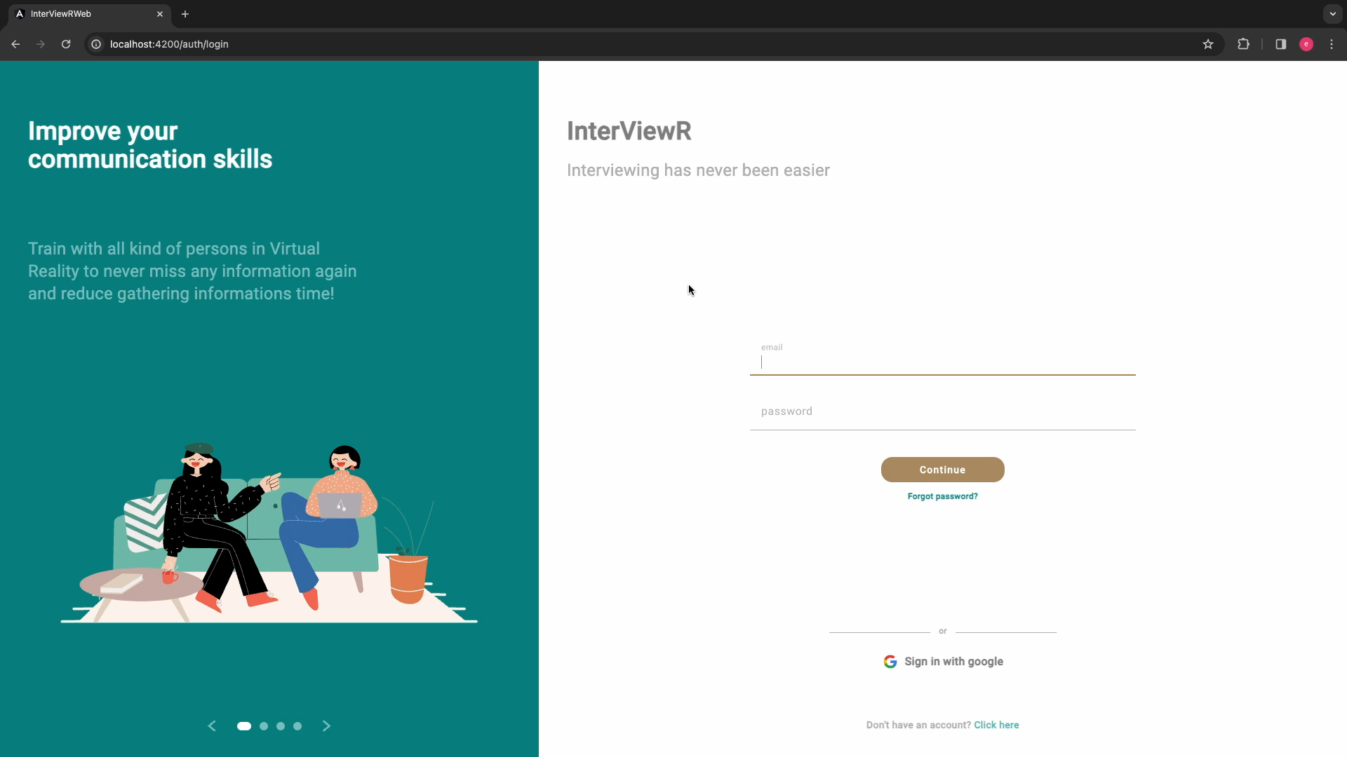
DEMO VIDEO – ALEX THOMPSON

Slide 18

DEMO VIDEO – MARTHA LUTHER

Slide 19
Q & A

